Slide 1
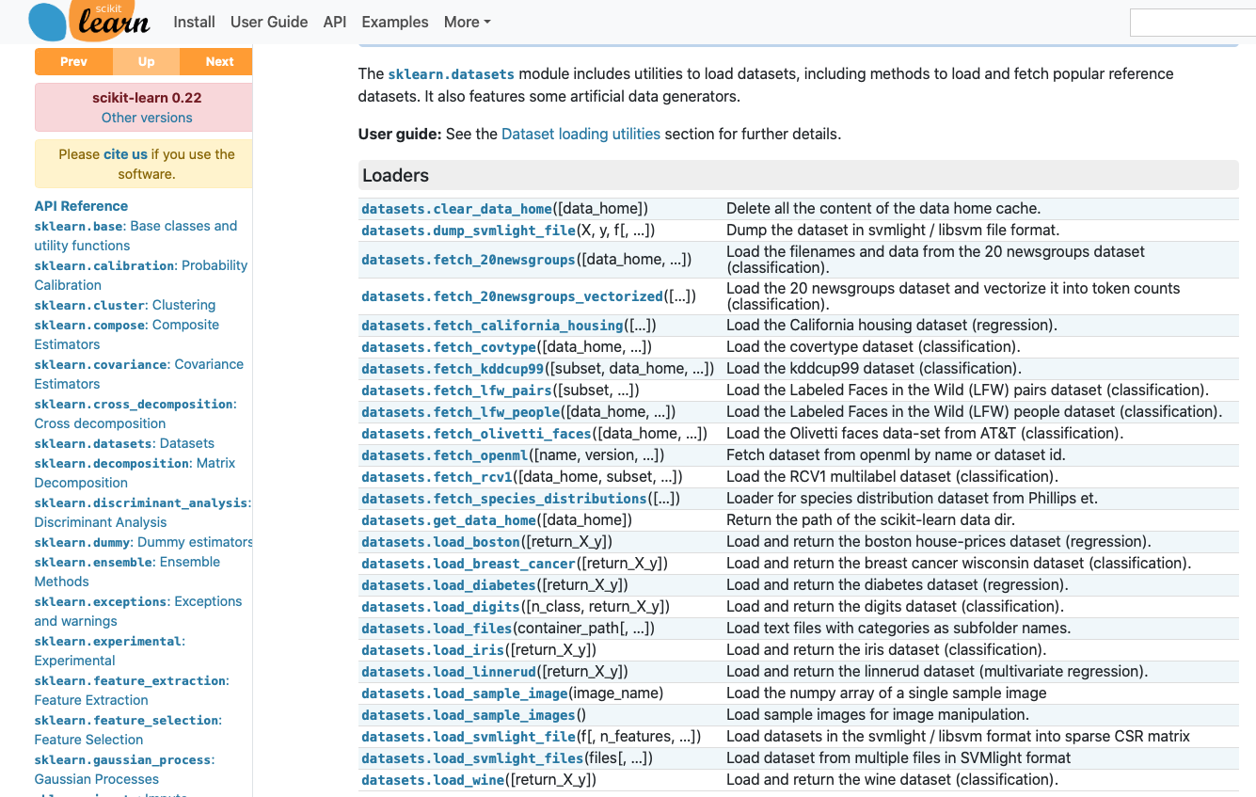

AWS Machine Learning - Gathering Data
Retrieve data from Scikit-learn
Scikit-learn has many datasets for use in your modeling
Similar to the Kaggle and Reddit dataset repositories

Slide 2
AWS Machine Learning - Gathering Data
Example code
Use SageMaker jupyter notebook to load dataset from Scikit-learn
We’ll use this code in our next module where we’ll clean the data

